Slide 1
Employee Data Analysis using Excel
STUDENT NAME: BANU PRIYA.S
REGISTER NO: 312209818
NM ID:CC4C9F9397DC672BE054A321B3C6D07F
DEPARTMENT:B.COM ACCOUNTING ANDFINANCE)
COLLEGE:VALLIAMMAL COLLEGE FOR WOMEN

Slide 2
PROJECT TITLE
Employee Performance Analysis using Excel

Slide 3


AGENDA
Problem Statement
Project Overview
End Users
Our Solution and Proposition
Dataset Description
Modelling Approach
Results and Discussion
Conclusion
3/21/2024 Annual Review

Slide 4

PROBLEM STATEMENT
Employee performance analysis, also known as performance reviews or evaluations, serves two main purposes: accurately assessing job performance and facilitating skill development. Organizations use this process to provide feedback to employees, document their performance, and identify areas for improvement. Most companies conduct performance evaluations annually.

Slide 5

PROJECT OVERVIEW
Improve Productivity: Performance evaluations help identify areas for improvement, ensuring employees meet expectations and contribute effectively to the organization’s success.
Identify Mistakes: By pinpointing errors, managers and employees can collaborate on solutions and prevent recurring issues, fostering a more secure work environment.
Provide Promotion Opportunities: Documentation from appraisals aids leadership in deciding which employees deserve promotions based on their performance

Slide 6

WHO ARE THE END USERS?
Employees
Managers
HR Departments
Organizations

Slide 7

OUR SOLUTION AND ITS VALUE PROPOSITION
Conditional Formatting: It is a feature that changes the appearance of cells in a range based on certain conditions, or rules.
Filtering: It is a powerful tool introduced in Excel 365, Excel 2021, and Excel Online. It allows you to retrieve data based on specific criteria from a range or array.
Pivot Table : Pivot Table is a tool that allows you to summarize, analyze, and calculate data in an interactive way.
Data Visualization:It is the process of using visual elements to represent data, such as charts, graphs, or maps.

Slide 8
Dataset Description
Employee ID[Numerical values]
First Name& Last name[text]
Employee status
Employee type
Performance level
Gender
Employee rating
Business unit

Slide 9

THE "WOW" IN OUR SOLUTION
.
PERFORMANCE LEVEL
=IFS(Z8>=5,"VERYHIGH",Z8>=4,"High",Z8>=3"Medium"True,"Low")
3/21/2024 Annual Review
9

Slide 10
MODELLING
Data Collection-Download from Kaggle.com
Feature Selection-The method of reducing the input variable to your model by using only relevant data and getting rid of noise in data.
Data Cleaning-The process of fixing or removing incorrect, incomplete, or duplicate data in a dataset
Performance Level-Calculate the performance level of employees by considering the current employee rating column
PIVOT TABLE-To summarize the employee analysis
GRAPH-To visualize the data through graphical representation
10

Slide 11
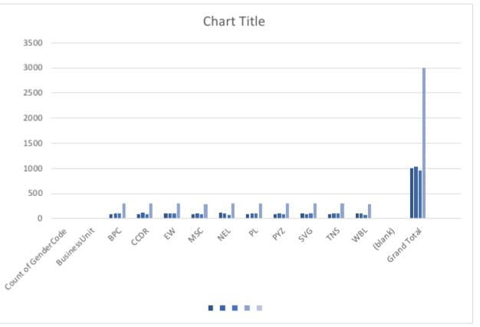
RESULTS
11

Slide 12
conclusion
Employee performance analysis can summarize a person's performance over a review period, highlight their strengths, and identify areas for improvement
Existing Employee performance analysis systems come to a conclusion post observing the performance of the employee. The recruitments of new employees are manually done by assessing the candidate on his /her various skills.

